Slide 1
Ensemble Learning based Intrusion Detection System CSI5388/ELG5271 – AI for Cybersecurity Applications. Final Project
Presented By
Mahitha Sangem | Surya Kiran Suresh | U Aditya Karanth | Vineeth Balusani
Carleton University University of Ottawa University of Ottawa University of Ottawa
Project Mentor:
Paul Mvula
Notes:
Greet

Slide 2
Introduction and Motivation
Ensemble Learning
Single model cannot identify all threats
Ensemble Learning uses multiple models
Base learners are combined strategically
Works as a single model
Improves performance
Better results when base learners are diversified and independent
Two types – Homogeneous and Heterogeneous
Ensembles can also be categorized as -
Bagging
Boosting
Stacking
Cascading
Intrusion Detection System
Monitors Network Traffic
Detects Suspicious activities
Alerts Administrators or other responsible teams
Two types – Signature-based and anomaly-based
Signature-based uses known patterns
New patterns emerge all the time
Anomaly-based employ Machine Learning
Characteristics of ideal IDS -
Low Generalization Error
Low False Alarm Rate
High Adaptability
High Scalability
IDS continues to suffer from the False Alarm Rate
Objective
Develop IDS using Ensemble Learning that correctly identifies the intrusions in the network traffic while keeping the false alarm rate low

Slide 3
Dataset
NSL-KDD is the benchmark for current internet traffic
Overcomes the problems of KDD’99
Data Redundancy
Bias towards specific attacks
Dataset comes with both Train and Test data
Train data – 125973 instances ; Test data – 22544 instances
41 Features (Independent Variables) and Dependent Variable – Attack
Features can be categorized as
Intrinsic Features – Information about packet
Content Features – Information to access the content in the payload
Time-based Features – Information about counts like the number of connection attempts to a host in a 2-second window
Host-based Features – Similar to time-based, but derived by analyzing the number of requests made to a host over n number of connections

Slide 4
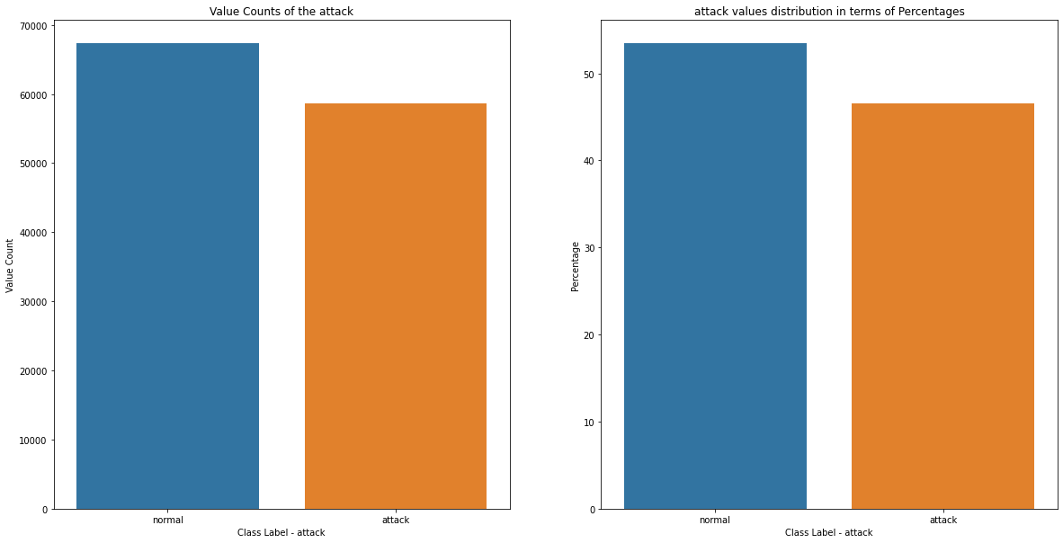
Dataset
Various types of features
Categorical – 3 features; Discrete – 22 features
Continuous – 10 features; Binary – 6 features
Different Attacks belonging to categories
Denial of Service – smurf, neptune, back, pod, land, teardrop
Probe – satan, ipsweep, portsweep, nmap
Remote to local – spy, phf, multihop, ftp_write, warezclient,
guess_password, warezmaster, imap
User to root – rootkit, perl, loadmodule, buffer_overflow
Converted to Binary Classification problem
Normal remained Normal
All attack types changed to Attack
Imbalanced Data
Normal instances – 67343 (53.46%)
Attack instances – 58630 (46.54%)
Metric for Evaluation – f1-score, Precision, Recall

Slide 5
Data Pre-processing
Missing values and Duplicate Data
Removed outliers for numerical features
Handling of categorical features
Target Encoding – p(y_{i} =attack | x_{i}) where x_{i} are unique values in the feature
for features – service (70 unique values); flag (11 unique values)
One Hot Encoding – for feature protocol_type (3 unique values – icmp, tcp, and udp)
Data Normalization
Filtered out features based on
Variance Thresholding – Removing features that exhibit zero variance
Pearson Correlation Coefficient (PCC) between pair of features – Removing one feature amongst a pair of highly correlated feature
Used threshold value of 0.9
if PCC(A,B) > 0.9, remove A if PCC(A, Target label) < PCC(B, Target label), if not remove B
Obtained Processed Train Data

Slide 6
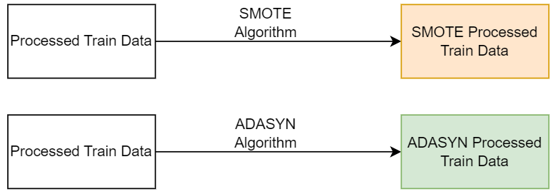
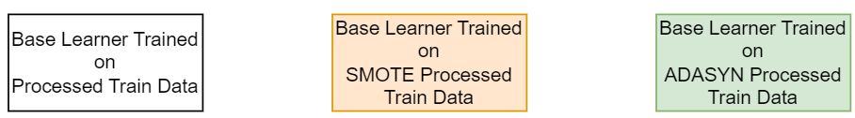
Methodology - Training Base Learners
Used data balancing techniques – SMOTE and ADASYN on Processed Train Data
Obtained two more training sets – SMOTE Processed Train Data; ADASYN Processed Train Data
Using Hyperparameter Tuning and 5 fold CV trained base learner independently on each of the three Train sets
Compared CV scores and selected the base learner model parameters and its corresponding training dataset for the next steps

Slide 7

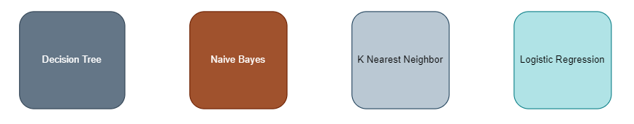
Methodology - Training Base Learners
Obtained a set of features using PCA with a 5-fold CV on the ADASYN training set obtained from the previous step
Similarly obtained another set of features using the Wrapper Method instead of PCA
Trained two independent base learners one each on the set of features obtained from PCA and Wrapper Method which would be used as input to the Stacking Classifiers
Used f1-score as the evaluation metric for the evaluation of the models at different steps
Four different base learners commonly found in the literature review

Slide 8
Results – Base Learners
Decision Tree
K Nearest Neighbors
Imbalance Technique | CV f1-score
- | 0.9980324538371492
SMOTE | 0.9980049698317799
ADASYN | 0.9815950274308483
Imbalance Technique | CV f1-score
- | 0.997418003327534
SMOTE | 0.9977436071084005
ADASYN | 0.9906148518463043
Naïve Bayes
Logistic Regression
Imbalance Technique | CV f1-score
- | 0.9579125819036907
SMOTE | 0.9607588809467945
ADASYN | 0.928302574273388
Imbalance Technique | CV f1-score
- | 0.9797426844580166
SMOTE | 0.9809223616367435
ADASYN | 0.9278984247506564
Continued to use ADASYN – Handles Imbalance; Better than SMOTE; Generalizes well on unseen data

Slide 9
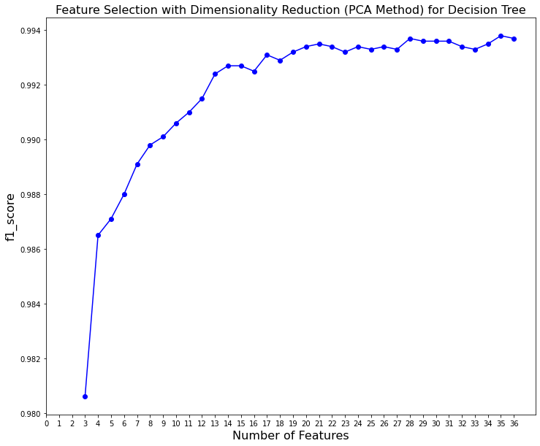
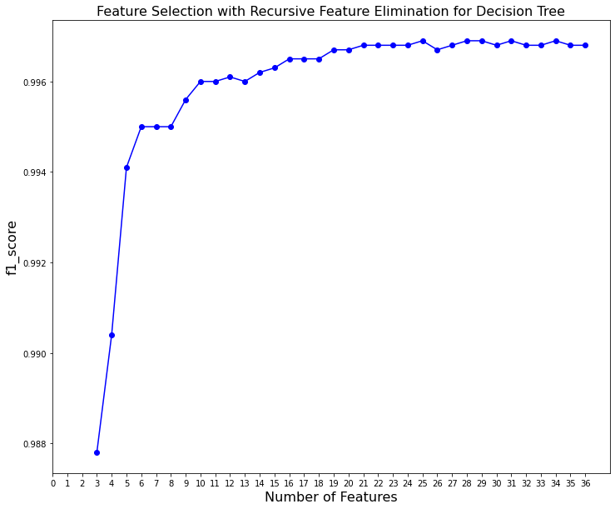
Results – Base Learners
Decision Tree – {criterion='entropy', max_depth=20, min_samples_leaf=5, Data is ADASYN }
PCA Method RFE Method
Number of Features – 35 (Variance Retained – 100%) Number of Features – 25
CV - f1-score – 0.9938 CV - f1-score – 0.9969

Slide 10
Results – Base Learners
Decision Tree – Results on Test Dataset
Classifier | Imbalance Technique | Hyperparameter Tuning | Feature Selection | Accuracy | F1-Score | Precision | Recall | AUC | AP
Decision Tree | - | No | - | 0.7832 | 0.7711 | 0.9664 | 0.641 | 0.81 | 0.82
Decision Tree | SMOTE | No | - | 0.7854 | 0.7741 | 0.966 | 0.646 | 0.81 | 0.83
Decision Tree | ADASYN | No | - | 0.8035 | 0.7972 | 0.9665 | 0.678 | 0.82 | 0.84
Decision Tree | - | Yes | - | 0.7965 | 0.788 | 0.9679 | 0.665 | 0.82 | 0.83
Decision Tree | SMOTE | Yes | - | 0.7981 | 0.7901 | 0.9679 | 0.668 | 0.82 | 0.84
Decision Tree | ADASYN | Yes | - | 0.8335 | 0.8403 | 0.9255 | 0.77 | 0.84 | 0.84
Decision Tree | ADASYN | Yes | PCA (35) | 0.7832 | 0.7726 | 0.9588 | 0.647 | 0.81 | 0.82
Decision Tree | ADASYN | Yes | RFE (25) | 0.831 | 0.8375 | 0.9252 | 0.765 | 0.84 | 0.84

Slide 11
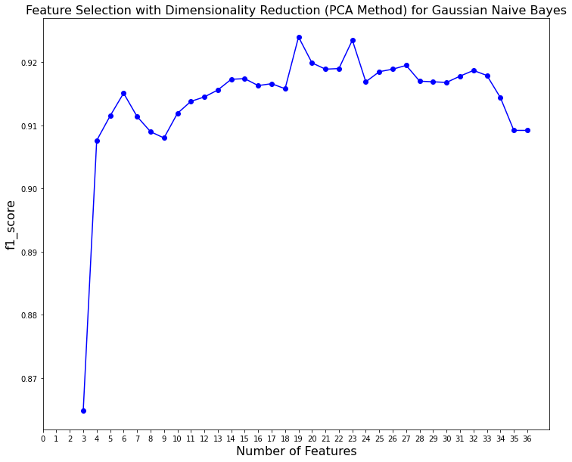
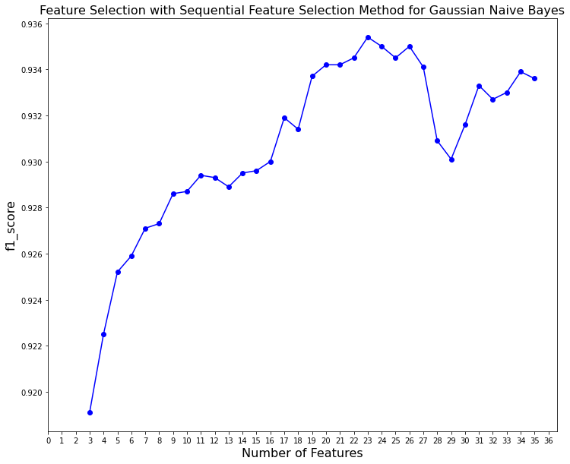
Results – Base Learners
Naïve Bayes – { var_smoothing=0.000000001, Data is ADASYN }
PCA Method SFS Method
Number of Features – 19 (Variance Retained – 99.1244%) Number of Features – 23
CV - f1-score – 0.924 CV - f1-score – 0.9354

Slide 12
Results – Base Learners
Naïve Bayes– Results on Test Dataset
Classifier | Imbalance Technique | Hyperparameter Tuning | Feature Selection | Accuracy | F1-Score | Precision | Recall | AUC | AP
Naïve Bayes | - | No | - | 0.8068 | 0.8121 | 0.9096 | 0.7335 | 0.82 | 0.82
Naïve Bayes | SMOTE | No | - | 0.8067 | 0.8121 | 0.9092 | 0.7338 | 0.82 | 0.82
Naïve Bayes | ADASYN | No | - | 0.8275 | 0.8343 | 0.9204 | 0.763 | 0.84 | 0.84
Naïve Bayes | - | Yes | - | 0.8087 | 0.8121 | 0.921 | 0.7263 | 0.82 | 0.82
Naïve Bayes | SMOTE | Yes | - | 0.8088 | 0.8123 | 0.9207 | 0.7267 | 0.82 | 0.82
Naïve Bayes | ADASYN | Yes | - | 0.8275 | 0.8343 | 0.9204 | 0.763 | 0.84 | 0.84
Naïve Bayes | ADASYN | Yes | PCA (19) | 0.8633 | 0.8779 | 0.8931 | 0.8632 | 0.86 | 0.85
Naïve Bayes | ADASYN | Yes | SFS (23) | 0.7992 | 0.8026 | 0.9114 | 0.717 | 0.81 | 0.81

Slide 13
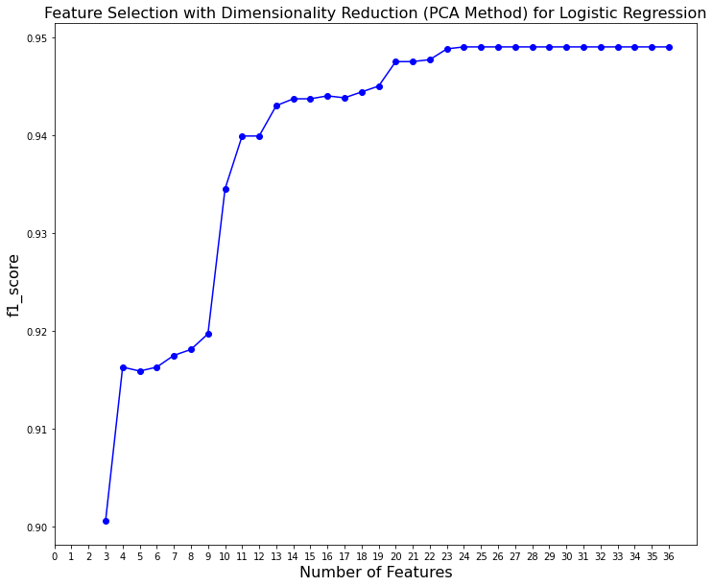
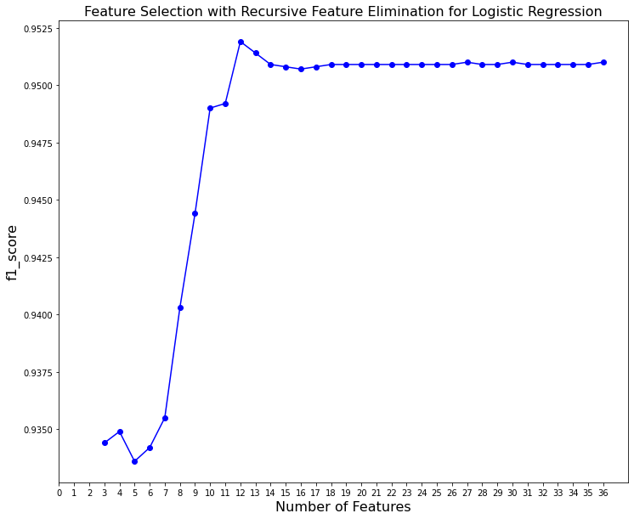
Results – Base Learners
Logistic Regression – {C=0.012742749857031334, max_iter=1000, penalty='l1’, solver=‘liblinear’, Data is ADASYN }
PCA Method RFE Method
Number of Features – 26 (Variance Retained – 99.9372%) Number of Features – 12
CV - f1-score – 0.949 CV - f1-score – 0.9519

Slide 14
Results – Base Learners
Logistic Regression – Results on Test Dataset
Classifier | Imbalance Technique | Hyperparameter Tuning | Feature Selection | Accuracy | F1-Score | Precision | Recall | AUC | AP
Logistic Regression | - | No | - | 0.7812 | 0.7782 | 0.92 | 0.6744 | 0.8 | 0.81
Logistic Regression | SMOTE | No | - | 0.7816 | 0.7788 | 0.9198 | 0.6753 | 0.8 | 0.81
Logistic Regression | ADASYN | No | - | 0.7925 | 0.7928 | 0.9182 | 0.6975 | 0.81 | 0.81
Logistic Regression | - | Yes | - | 0.7811 | 0.7781 | 0.9198 | 0.6742 | 0.8 | 0.81
Logistic Regression | SMOTE | Yes | - | 0.7819 | 0.7792 | 0.9196 | 0.6759 | 0.8 | 0.81
Logistic Regression | ADASYN | Yes | - | 0.7917 | 0.7920 | 0.9175 | 0.6967 | 0.81 | 0.81
Logistic Regression | ADASYN | Yes | PCA (26) | 0.7972 | 0.7984 | 0.9196 | 0.7054 | 0.81 | 0.82
Logistic Regression | ADASYN | Yes | RFE (12) | 0.799 | 0.8015 | 0.9152 | 0.713 | 0.81 | 0.82

Slide 15
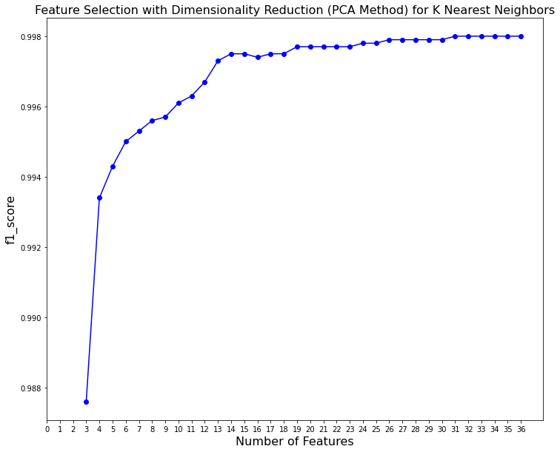
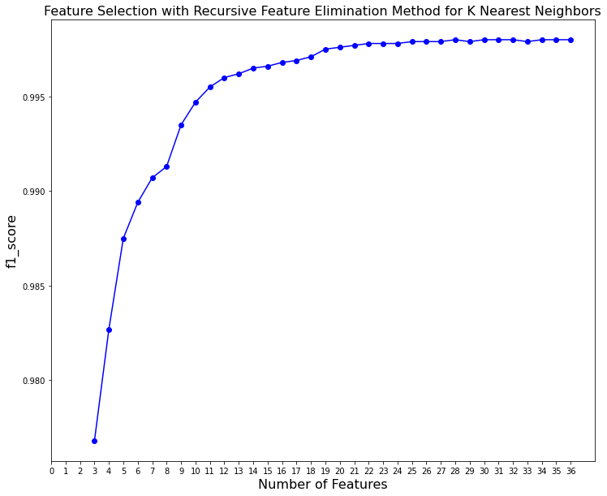
Results – Base Learners
K Nearest Neighbors – {n_neighbors=1, Data is ADASYN}
PCA Method RFE Method
Number of Features – 31 (Variance Retained – 99.9965%) Number of Features – 28
CV - f1-score – 0.998 CV - f1-score – 0.998
Utilized Decision Tree for the RFE method

Slide 16
Results – Base Learners
K Nearest Neighbors – Results on Test Dataset
Classifier | Imbalance Technique | Hyperparameter Tuning | Feature Selection | Accuracy | F1-Score | Precision | Recall | AUC | AP
KNN | - | No | - | 0.7876 | 0.778 | 0.9607 | 0.6536 | 0.81 | 0.83
KNN | SMOTE | No | - | 0.7929 | 0.7848 | 0.9607 | 0.6634 | 0.81 | 0.83
KNN | ADASYN | No | - | 0.8253 | 0.8247 | 0.9621 | 0.7216 | 0.84 | 0.85
KNN | - | Yes | - | 0.8058 | 0.8005 | 0.9636 | 0.6846 | 0.83 | 0.84
KNN | SMOTE | Yes | - | 0.806 | 0.8008 | 0.9635 | 0.6851 | 0.83 | 0.84
KNN | ADASYN | Yes | - | 0.812 | 0.8083 | 0.9634 | 0.6962 | 0.83 | 0.84
KNN | ADASYN | Yes | PCA (31) | 0.8122 | 0.8086 | 0.9635 | 0.6966 | 0.83 | 0.84
KNN | ADASYN | Yes | RFE (28) | 0.8094 | 0.8050 | 0.9642 | 0.6909 | 0.83 | 0.84

Slide 17
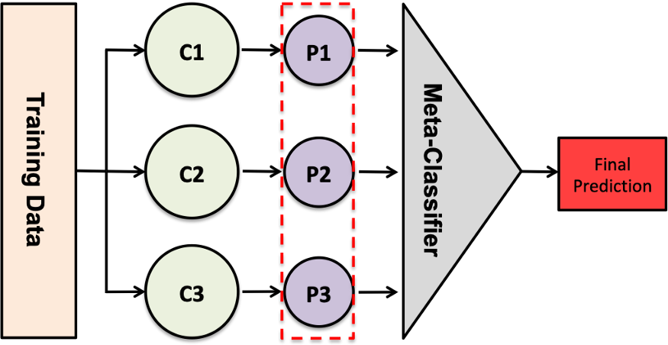
Methodology - Training Stacking Classifiers
Stacking
Stacking is an ensemble learning approach
Combines multiple Machine Learning Algorithms via meta-learning
Predictions of base learners are used as features to train Meta Classifier
Meta Classifier is responsible for the final prediction
Can be thought of as an extension to Voting Classifier
Useful when we have varied base learners
Stacking is well known to improve the overall predictive performance
Source – TDS Blog

Slide 18

Methodology - Training Stacking Classifiers
Stacking Classifiers used
Random Forest
AdaBoost
XGBoost
Gradient-Boosted Decision Tree
Stacking Classifiers on Base Learners (PCA Features)
Stacking Classifiers on Base Learners (Wrapper Features)
Stacking Classifiers
Random Forest
AdaBoost
XGBoost
GBDT

Slide 19
Results - Stacking Classifiers
Stacking Classifier | Base Learners | Feature Selection On Base Learners | Accuracy | F1-Score | Precision | Recall | AUC | AP
Random Forest | DT, NB, LR, KNN | Wrapper | 0.8471 | 0.85 | 0.9623 | 0.7612 | 0.86 | 0.87
AdaBoost | DT, NB, LR, KNN | Wrapper | 0.8376 | 0.8394 | 0.9597 | 0.746 | 0.85 | 0.86
XGBoost | DT, NB, LR, KNN | Wrapper | 0.8449 | 0.8477 | 0.9613 | 0.7581 | 0.86 | 0.87
GBDT | DT, NB, LR, KNN | Wrapper | 0.8473 | 0.8506 | 0.9604 | 0.7633 | 0.86 | 0.87
Random Forest | DT, NB, LR, KNN | PCA | 0.8172 | 0.8149 | 0.9615 | 0.7071 | 0.83 | 0.85
AdaBoost | DT, NB, LR, KNN | PCA | 0.8139 | 0.8111 | 0.9608 | 0.7017 | 0.83 | 0.84
XGBoost | DT, NB, LR, KNN | PCA | 0.8149 | 0.8122 | 0.9612 | 0.7032 | 0.83 | 0.84
GBDT | DT, NB, LR, KNN | PCA | 0.8157 | 0.8135 | 0.9599 | 0.7058 | 0.83 | 0.84
DT – Decision Tree, NB – Naïve Bayes, LR – Logistic Regression; KNN – K Nearest Neighbor
Wrapper Methods – NB uses SFS; DT, LR and KNN use RFE

Slide 20
Methodology – Logical OR on Stacking Classifier Predictions
Between the pair of Stacking Classifier Predictions perform Logical OR operation
4C2 combinations hence 6 outputs from this methodology
for base learners trained on PCA and Wrapper features
Prediction of Stacking Classifier x (0 – normal 1 – attack) | Prediction of Stacking Classifier y (y ≠ x) (0 – normal 1 – attack) | Logical OR Output (0 – normal 1 – attack)
0 | 0 | 0
0 | 1 | 1
1 | 0 | 1
1 | 1 | 1

Slide 21
Results – Logical OR on Stacking Classifier Predictions
Stacking Classifiers trained on Base Learners that use Wrapper-based features
Stacking Classifier 1 | Stacking Classifier 2 | Accuracy | F1-Score | Precision | Recall | AUC | AP
Random Forest | AdaBoost | 0.8589 | 0.8636 | 0.9597 | 0.785 | 0.87 | 0.88
Random Forest | XGBoost | 0.8522 | 0.856 | 0.9606 | 0.7719 | 0.87 | 0.87
Random Forest | GBDT | 0.8606 | 0.8654 | 0.9603 | 0.7877 | 0.87 | 0.88
AdaBoost | XGBoost | 0.8547 | 0.859 | 0.9595 | 0.7775 | 0.87 | 0.87
AdaBoost | GBDT | 0.8507 | 0.8545 | 0.9597 | 0.7701 | 0.86 | 0.87
XGBoost | GBDT | 0.8601 | 0.8649 | 0.9602 | 0.7869 | 0.87 | 0.88

Slide 22
Results – Logical OR on Stacking Classifier Predictions
Stacking Classifiers trained on Base Learners that use PCA-based features
Stacking Classifier 1 | Stacking Classifier 2 | Accuracy | F1-Score | Precision | Recall | AUC | AP
Random Forest | AdaBoost | 0.8194 | 0.8178 | 0.9604 | 0.7121 | 0.84 | 0.85
Random Forest | XGBoost | 0.8201 | 0.8186 | 0.9612 | 0.7128 | 0.84 | 0.85
Random Forest | GBDT | 0.8202 | 0.8189 | 0.9597 | 0.7141 | 0.84 | 0.85
AdaBoost | XGBoost | 0.8168 | 0.8147 | 0.9604 | 0.7073 | 0.83 | 0.85
AdaBoost | GBDT | 0.8157 | 0.8135 | 0.9598 | 0.7058 | 0.83 | 0.84
XGBoost | GBDT | 0.8173 | 0.8154 | 0.9598 | 0.7087 | 0.83 | 0.85

Slide 23
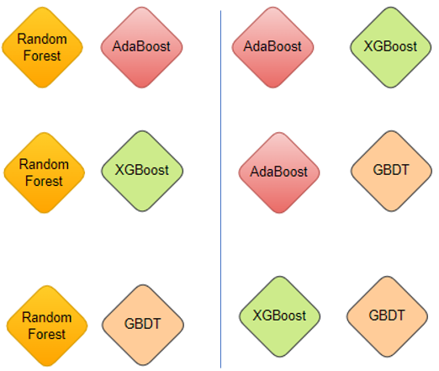
Methodology – Aggregation of Predictions
14 different predictions
4 Base Learners
4 Stacking Classifiers
6 Logical OR
Sum of all the 14 Predictions – “sum_predictions”
For the entire train dataset
For the entire test dataset
Range – [1,14]
sum_predictions >= threshold (iterated in Range – [1,14])
True – Predict 1
False – Predict 0
threshold should be obtained using the training dataset
Can be thought of Hyperparameter

Slide 24
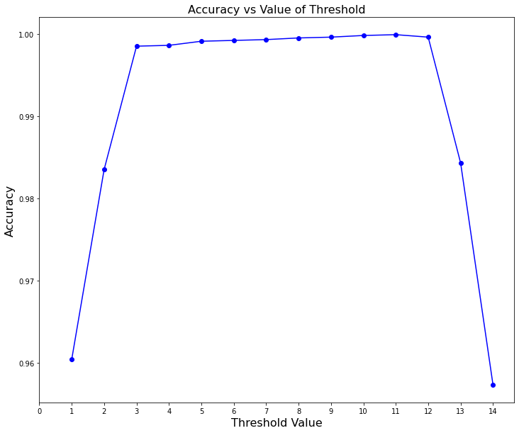
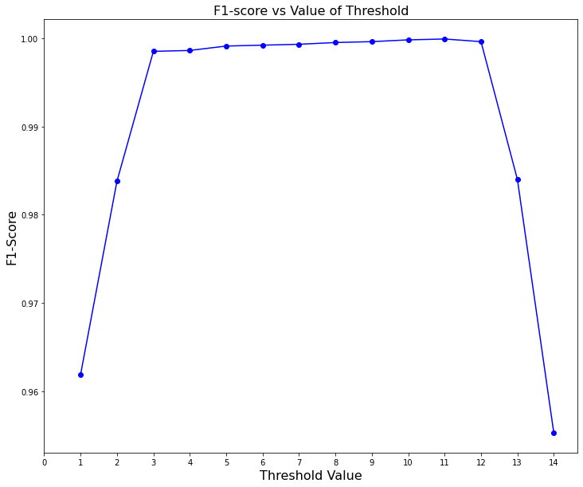
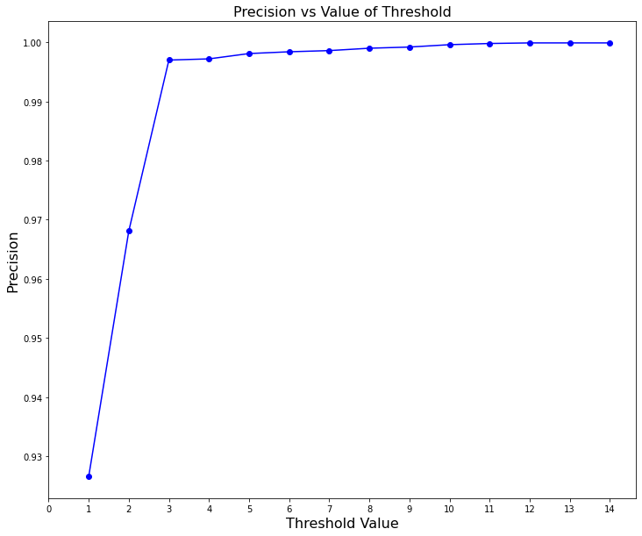
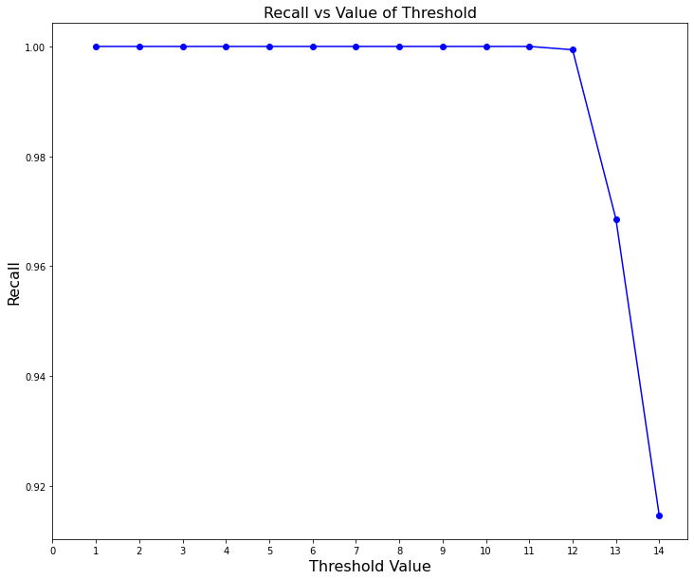
Methodology – Aggregation of Predictions
Base Learners, Stacking Classifiers trained using Wrapper-based features, and Logical OR between Stacking Classifiers
Entire Train Data
Accuracy – 0.9999 for Threshold = 11 f1-score – 0.9999 for Threshold = 11
Precision – 0.9999 for Threshold = 12 Recall – 1 for Threshold = 1
5-fold CV on Train Data Set
Accuracy – 0.9999 for Threshold = 11 f1-score – 0.9999 for Threshold = 11
Precision – 0.9999 for Threshold = 13 Recall – 1 for Threshold = 1

Slide 25
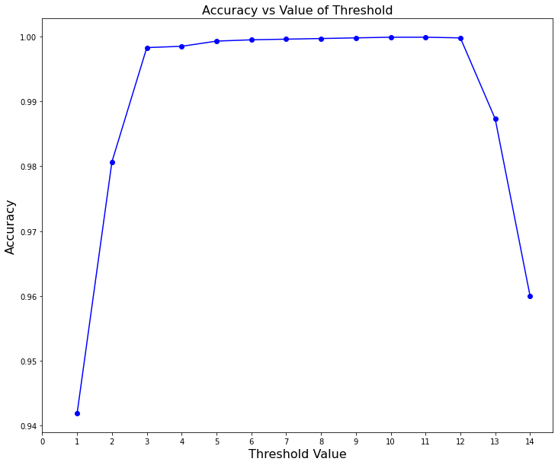
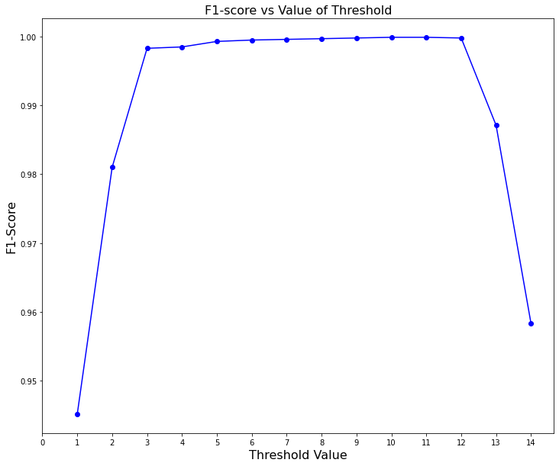
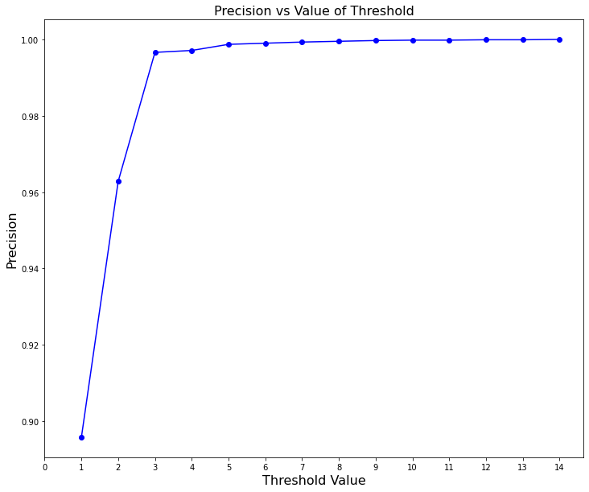
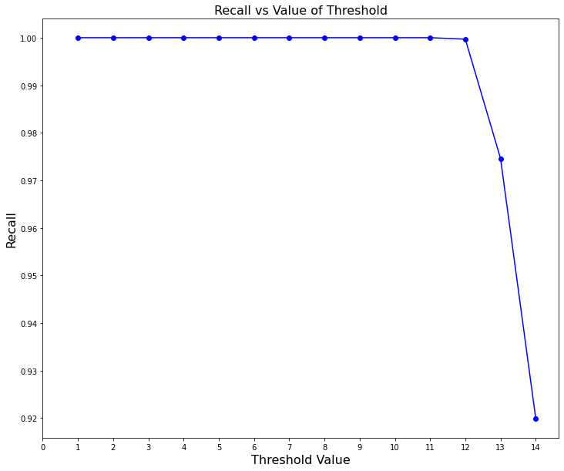
Methodology – Aggregation of Predictions
Base Learners, Stacking Classifiers trained using PCA-based features, and Logical OR between Stacking Classifiers
Entire Train Data
Accuracy – 0.9999 for Threshold = 10 f1-score – 0.9999 for Threshold = 10
Precision – 1 for Threshold = 14 Recall – 1 for Threshold = 1
5-fold CV on Train Data Set
Accuracy – 0.9999 for Threshold = 10 f1-score – 0.9999 for Threshold = 10
Precision – 1 for Threshold = 14 Recall – 1 for Threshold = 1

Slide 26
Results – Aggregation of Predictions
Base Learners, Stacking Classifiers trained using Wrapper-based features, and Logical OR between Stacking Classifiers
Threshold Value | Accuracy | F1-Score | Precision | Recall | AUC | AP
1 | 0.8601 | 0.8791 | 0.9104 | 0.8365 | 0.86 | 0.85
11 | 0.8282 | 0.8281 | 0.9619 | 0.727 | 0.84 | 0.85
13 | 0.7925 | 0.7839 | 0.9627 | 0.6611 | 0.81 | 0.83
Base Learners, Stacking Classifiers trained using PCA-based features, and Logical OR between Stacking Classifiers
Threshold Value | Accuracy | F1-Score | Precision | Recall | AUC | AP
1 | 0.8697 | 0.8851 | 0.8882 | 0.8821 | 0.87 | 0.85
10 | 0.8157 | 0.8131 | 0.9617 | 0.7043 | 0.83 | 0.85
14 | 0.7576 | 0.7356 | 0.9704 | 0.5923 | 0.78 | 0.81

Slide 27
Methodology – Logical AND on Stacking Classifier Predictions
Between the pair of Stacking Classifier Predictions perform Logical AND operation
4C2 combinations hence 6 outputs from this methodology
for base learners trained on PCA and Wrapper features
Prediction of Stacking Classifier x (0 – normal 1 – attack) | Prediction of Stacking Classifier y (y ≠ x) (0 – normal 1 – attack) | Logical AND Output (0 – normal 1 – attack)
0 | 0 | 0
0 | 1 | 0
1 | 0 | 0
1 | 1 | 1

Slide 28
Results – Logical AND on Stacking Classifier Predictions
Stacking Classifiers trained on Base Learners that use Wrapper-based features
Stacking Classifier 1 | Stacking Classifier 2 | Accuracy | F1-Score | Precision | Recall | AUC | AP
Random Forest | AdaBoost | 0.8258 | 0.8251 | 0.9624 | 0.7221 | 0.84 | 0.85
Random Forest | XGBoost | 0.8398 | 0.8416 | 0.963 | 0.7474 | 0.85 | 0.86
Random Forest | GBDT | 0.8338 | 0.8346 | 0.9624 | 0.7368 | 0.85 | 0.86
AdaBoost | XGBoost | 0.8278 | 0.8277 | 0.9615 | 0.7266 | 0.84 | 0.85
AdaBoost | GBDT | 0.8341 | 0.8354 | 0.9604 | 0.7391 | 0.85 | 0.86
XGBoost | GBDT | 0.8322 | 0.8328 | 0.9615 | 0.7345 | 0.85 | 0.86

Slide 29
Results – Logical AND on Stacking Classifier Predictions
Stacking Classifiers trained on Base Learners that use PCA-based features
Stacking Classifier 1 | Stacking Classifier 2 | Accuracy | F1-Score | Precision | Recall | AUC | AP
Random Forest | AdaBoost | 0.8117 | 0.8082 | 0.962 | 0.6967 | 0.83 | 0.84
Random Forest | XGBoost | 0.8119 | 0.8085 | 0.9615 | 0.6975 | 0.83 | 0.84
Random Forest | GBDT | 0.8127 | 0.8094 | 0.9618 | 0.6987 | 0.83 | 0.84
AdaBoost | XGBoost | 0.8120 | 0.8086 | 0.9617 | 0.6976 | 0.83 | 0.84
AdaBoost | GBDT | 0.8139 | 0.8111 | 0.9609 | 0.7016 | 0.83 | 0.84
XGBoost | GBDT | 0.8133 | 0.8103 | 0.9614 | 0.7002 | 0.83 | 0.84

Slide 30
Methodology – Aggregation of Predictions
14 different predictions
4 Base Learners
4 Stacking Classifiers
6 Logical AND
Sum of all the 14 Predictions – “sum_predictions”
For the entire train dataset
For the entire test dataset
Range – [1,14]
sum_predictions >= threshold (iterated in Range – [1,14])
True – Predict 1
False – Predict 0
threshold should be obtained using the training dataset
Can be thought of Hyperparameter

Slide 31
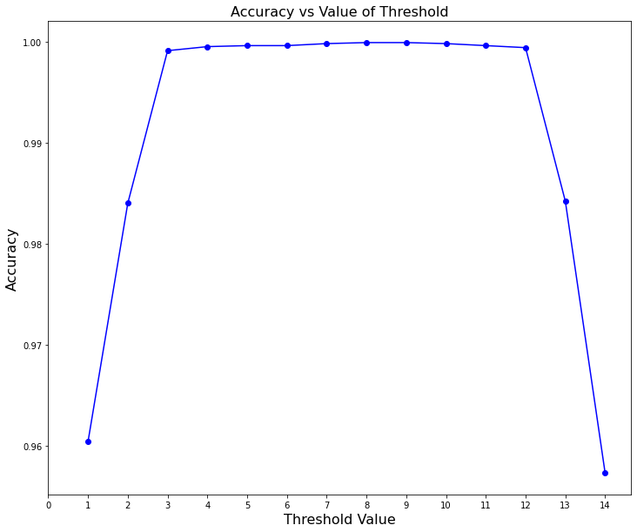

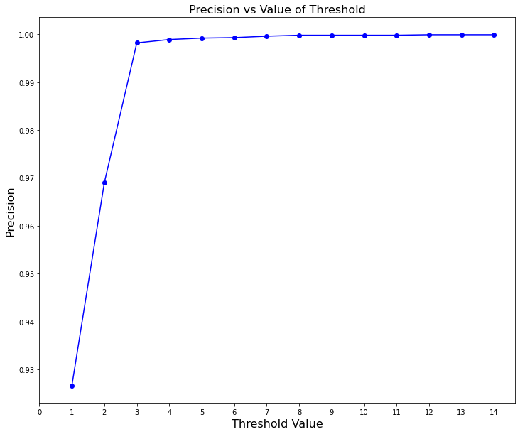

Methodology – Aggregation of Predictions
Base Learners, Stacking Classifiers trained using Wrapper-based features, and Logical AND between Stacking Classifiers
Entire Train Data
Accuracy – 0.9999 for Threshold = 8 f1-score – 0.9999 for Threshold = 8
Precision – 0.9999 for Threshold = 12 Recall – 1 for Threshold = 1
5-fold CV on Train Data Set
Accuracy – 0.9999 for Threshold = 8 f1-score – 0.9999 for Threshold = 8
Precision – 0.9999 for Threshold = 13 Recall – 1 for Threshold = 1

Slide 32
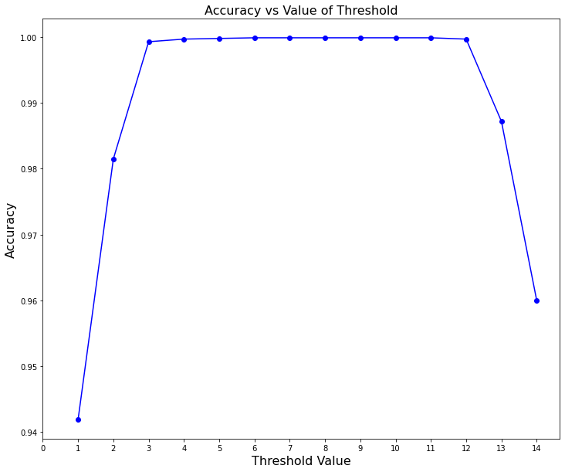
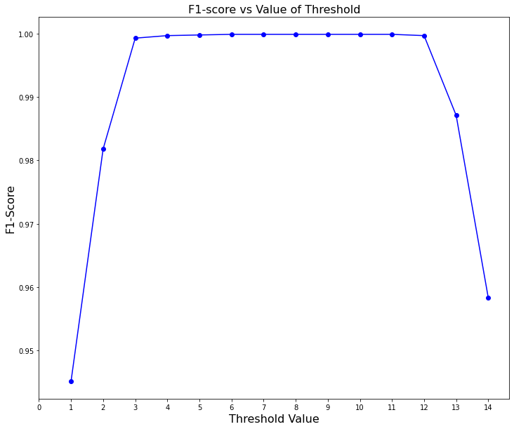
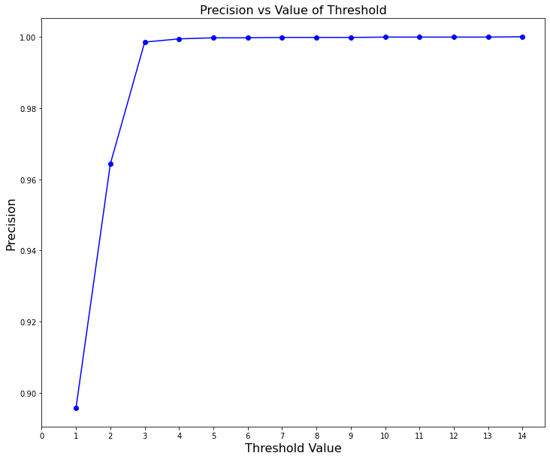

Methodology – Aggregation of Predictions
Base Learners, Stacking Classifiers trained using PCA-based features, and Logical AND between Stacking Classifiers
Entire Train Data
Accuracy – 0.9999 for Threshold = 6 f1-score – 0.9999 for Threshold = 6
Precision – 1 for Threshold = 14 Recall – 1 for Threshold = 1
5-fold CV on Train Data Set
Accuracy – 0.9999 for Threshold = 6 f1-score – 0.9999 for Threshold = 6
Precision – 1 for Threshold = 14 Recall – 1 for Threshold = 1

Slide 33
Results – Aggregation of Predictions
Base Learners, Stacking Classifiers trained using Wrapper-based features, and Logical AND between Stacking Classifiers
Threshold Value | Accuracy | F1-Score | Precision | Recall | AUC | AP
1 | 0.8601 | 0.8791 | 0.9104 | 0.8365 | 0.86 | 0.85
8 | 0.8282 | 0.8281 | 0.9619 | 0.727 | 0.84 | 0.85
13 | 0.7925 | 0.7839 | 0.9627 | 0.6611 | 0.81 | 0.83
Base Learners, Stacking Classifiers trained using PCA-based features, and Logical AND between Stacking Classifiers
Threshold Value | Accuracy | F1-Score | Precision | Recall | AUC | AP
1 | 0.8697 | 0.8851 | 0.8882 | 0.8821 | 0.87 | 0.85
6 | 0.8157 | 0.8132 | 0.9617 | 0.7044 | 0.83 | 0.85
14 | 0.7576 | 0.7356 | 0.9704 | 0.5923 | 0.78 | 0.81

Slide 34
Observations and Conclusion
ADASYN was the right choice as base learners trained on ADASYN produced better results on Test Data
All the Base Learners have Precision Values above 0.9 while most of the Recall values are lesser than 0.75
Stacking Classifiers further improved the precision values but no change to the recall values
Training time when PCA features are involved is quite less than when Wrapper-based features are involved
Logical OR and Logical AND between the stacking model predictions have brought no noticeable changes to Precision and Recall values
Able to improve the Recall value using the Thresholding concept
Limited Trade-off for Precision while improving the Recall
No significant differences in performance when Logical AND is substituted with Logical OR
(Except the optimal Threshold value for Precision and Accuracy got lesser – due to lesser 1s which is because of Logical AND)
Thresholding on both methodologies, Logical OR and Logical AND between predictions, performed better for threshold = 1
AUC and AP were always in the range of 0.8 to 0.85 even if the recall was very low
Notes:
Fster RCNN is accurate but may not be typical for Realtime applications due to its detection speed.
Yolo is faster but not accurate, so a trade off between the detection accuracy and detection speed should be make for a given application

Slide 35
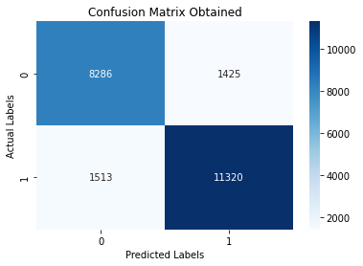
Observations and Conclusion
PCA produced more efficient results than Wrapper for threshold = 1 (f1-score, precision, recall – 0.88)
Confusion Matrix obtained when threshold = 1
Scope for improvement
Able to control Precision and Recall easily depending on the threshold
Easily able to adapt based on the cost of errors
Might not require hyperparameter tuning if the right set of base learners and stacking, classifiers along with the correct threshold are used
Might help in Dynamic Learning (by only varying the threshold value)
Notes:
Fster RCNN is accurate but may not be typical for Realtime applications due to its detection speed.
Yolo is faster but not accurate, so a trade off between the detection accuracy and detection speed should be make for a given application

Slide 36
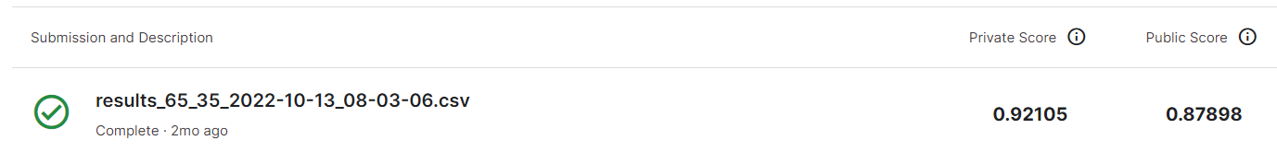
Challenges & Future Work
The big challenge was the computation time and hardware limitations.
SFS for KNN without DT
Work on Error Analysis and Interpretability (could be complex)
Distribution of data between train and test.
Firm belief that the 100% f1-score if train data was split into train and test
Try on a different dataset – very optimistic about the results
Combine Logical AND & Logical OR and then derive threshold
Try different base learners (with and without hyperparameter tuning), stacking classifiers
Try on Dynamic Learning by varying thresholds every time the performance drops

Slide 37
References
[1] M. Yousefnezhad, J. Hamidzadeh, and M. Aliannejadi, “Ensemble classification for intrusion detection via feature extraction based on deep Learning,” Detailed Analysis of the KDD CUP 99 Data Set,” Soft Comput., vol. 25, no. 20, pp. 12667–12683, Oct. 2021, DOI: 10.1007/s00500-021-06067-8.
[2] G. Kumar, K. Thakur, and M. R. Ayyagari, “MLEsIDSs: machine learning-based ensembles for intrusion detection systems a review,” J. Supercomput., vol. 76, no. 11, pp. 8938–8971, Nov. 2020, DOI: 10.1007/s11227-020-03196-z.
[3] I. Abrar, Z. Ayub, F. Masoodi, and A. M. Bamhdi, “A Machine Learning Approach for Intrusion Detection System on NSL-KDD Dataset,” in 2020 International Conference on Smart Electronics and Communication (ICOSEC), Trichy, India, Sep. 2020, pp. 919–924. DOI: 10.1109/ICOSEC49089.2020.9215232.
[4] NSL-KDD | Datasets | Research | Canadian Institute for Cybersecurity | UNB. https://www.unb.ca/cic/datasets/nsl.html. Accessed 22 Oct. 2022.
[5] I. Ahmad, M. Basheri, M. J. Iqbal, and A. Rahim, "Performance Comparison of Support Vector Machine, Random Forest, and Extreme Learning Machine for Intrusion Detection," in IEEE Access, vol. 6, pp. 33789-33795, 2018, DOI: 10.1109/ACCESS.2018.2841987.
[6] M. Tavallaee, E. Bagheri, W. Lu and A. A. Ghorbani, "A detailed analysis of the KDD CUP 99 data set," 2009 IEEE Symposium on Computational Intelligence for Security and Defense Applications, 2009, pp. 1-6, DOI: 10.1109/CISDA.2009.5356528.
[7] M. Govindarajan, “Evaluation of Ensemble Classifiers for Intrusion Detection,” World Academy of Science, Engineering and Technology, Open Science Index 114, International Journal of Computer and Information Engineering, vol. 10, no. 6, p. 9, 2016, DOI: 10.5281/zenodo.1124579.
[8] N. N. P. Mkuzangwe, F. Nelwamondo, N. N. P. Mkuzangwe, and F. Nelwamondo, “Ensemble of classifiers based network intrusion detection system performance bound,” in 2017 4th International Conference on Systems and Informatics (ICSAI), Hangzhou, Nov. 2017, pp. 970–974, DOI: 10.1109/ICSAI.2017.8248426.

Slide 38
References
[9] P. C. Nguyen, Q. T. Nguyen and K. H. Le, “An Ensemble Feature Selection Algorithm for Machine Learning Based Intrusion Detection System.” 2021 8th NAFOSTED Conference on Information and Computer Science (NICS), pp. 50–54, 2021, DOI: 10.1109/NICS54270.2021.9701577.
[10] S. Seth, K. K. Chahal, and G. Singh, “A Novel Ensemble Framework for an Intelligent Intrusion Detection System,” IEEE Access, vol. 9, pp. 138451–138467, 2021, DOI: 10.1109/ACCESS.2021.3116219.
[11] N. T. Pham, E. Foo, S. Suriadi, H. Jeffrey, and H. F. M. Lahza, “Improving performance of intrusion detection system using ensemble methods and feature selection,” in Proceedings of the Australasian Computer Science Week Multiconference, Brisbane Queensland Australia, Jan. 2018, pp. 1–6. DOI: 10.1145/3167918.3167951.
[12] Y. Zhou, T. A. Mazzuchi, and S. Sarkani, “M-AdaBoost-A based ensemble system for network intrusion detection,” Expert Syst. Appl., vol. 162, p. 113864, Dec. 2020, DOI: 10.1016/j.eswa.2020.113864.
[13] D. Rani, N. S. Gill, P. Gulia and J. M. Chatterjee, “An Ensemble-Based Multiclass Classifier for Intrusion Detection Using Internet of Things,” Computational Intelligence and Neuroscience, pp. 1-16, May. 2022, DOI: 10.1155/2022/1668676.
[14] R. Gangula, V. M. Mohan, and M. R. Kumar, “Network Intrusion Detection System for Internet of Things Based on Enhanced Flower Pollination Algorithm and Ensemble Classifier.” Concurrency and Computation: Practice and Experience, vol. 34, no. 21, Sept. 2022. DOI: 10.1002/cpe.7103.
[15] H. Choi, M. Kim, G. Lee, and W. Kim, “Unsupervised Learning Approach for Network Intrusion Detection System Using Autoencoders.” The Journal of Supercomputing, vol. 75, no. 9, Sept. 2019, pp. 5597–621, DOI: 10.1007/s11227-019-02805-w.
[16] S. Rawat, A. Srinivasan, and V. Ravi, “Intrusion Detection Systems Using Classical Machine Learning Techniques vs Integrated Unsupervised Feature Learning and Deep Neural Network.” Internet Technology Letters, vol. 5, no. 1, Jan. 2022, DOI: 10.1002/itl2.232.

Slide 39
Thank You!
Questions?

